Slide 1
Project on predicting co2 emission
Group 5 Members :
Medidi Jayanth Rama Krishna
Ashwini Shirishkumar Chobhe
Pooja Pandharinath Lokhande
Ponaganti Vinay Kumar
Bandru Vinaysai
MENTORS :
Varun Vennelaganti
Sunkarapelli Mounika

Slide 2
Business Objective:-
The fundamental goal here is to predict the CO2 emissions of cars based on several features of cars.
Reducing Carbon footprint is important because it s mitigates the effect of global climate change, improves, public health, boost the global economy, and maintain biodiversity.
When we cut carbon emissions, we help ensure cleaner air , water, and food for our generation and for generations yet to come

Slide 3
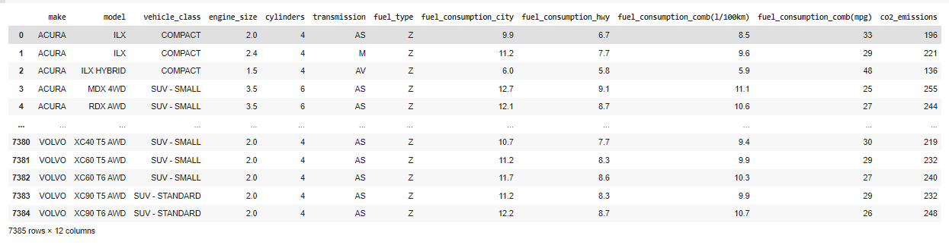
Details about the Dataset :
This dataset captures the details of how CO2 emissions by a vehicle can vary with the different features.
There are total 7385 rows and 12 columns.
Column name:-- Make= Company of the vehicle Model= Car model Vehicle Class= Class of vehicle depending on their utility, capacity and weight Engine Size = Size of engine used in Liter Cylinders= Number of cylinders Transmission = Transmission type with number of gears Fuel type =Type of Fuel used Fuel Consumption City=Fuel consumption in city roads (L/100 km) Fuel Consumption Hwy=Fuel consumption in Hwy roads (L/100 km) Fuel Consumption Comb=The combined fuel consumption (55% city, 45% highway) is shown in L/100 km Fuel Consumption Comb mpg =The combined fuel consumption in both city and highway is shown in mile per gallon(mpg)

Slide 4
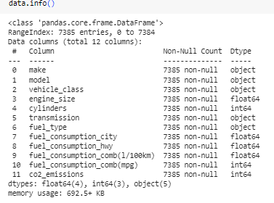
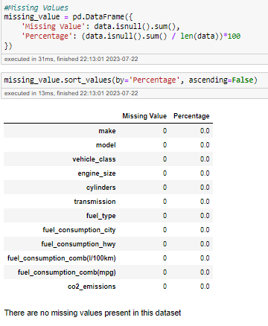
Info and missing values :
The dataset contains 4 object columns, 3 integer columns & 4 float columns.
We will convert object5 columns into categorical columns
The dataset don't have any missing & Null values

Slide 5
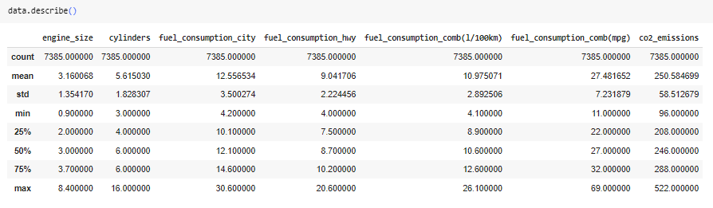
Describe :
1.The average amount of CO2 emitted from cars is 251 g/km
2.Atleast 4 Litters of fuel is consumed be it the car is on city roads or highway
3.About 75% of the cars have 6 or less cylinders
4.The amount of fuel consumed by cars on city roads is comparatively greater than that of highway

Slide 6
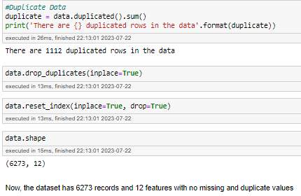
Duplicate Data :
There are 1112 duplicated rows in the dataset.
After dropping duplicated rows dataset contains 6273 rows and 12 columns

Slide 7
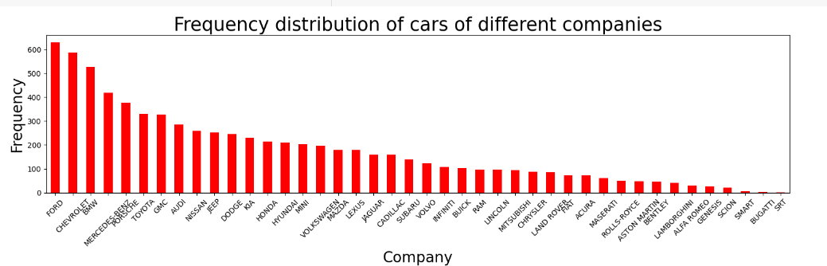
EXPLORATORY DATA ANALYSIS Visualization:- Frequency Distribution of different features:-
Most no of cars are FORD company
F-150FFV is most famous model in dataset.
SUV-small is preferred class of the vehicle

Slide 8
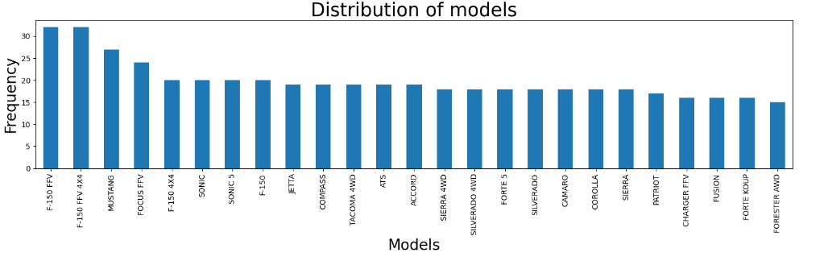
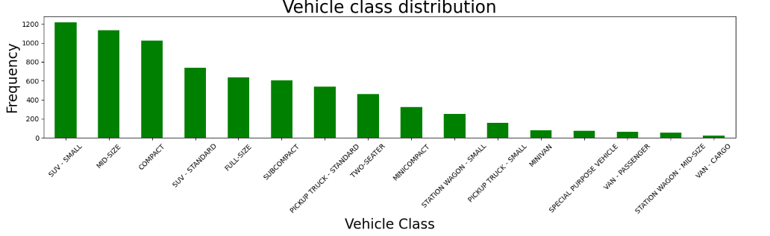

Slide 9
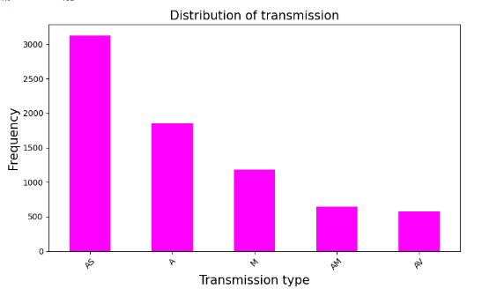
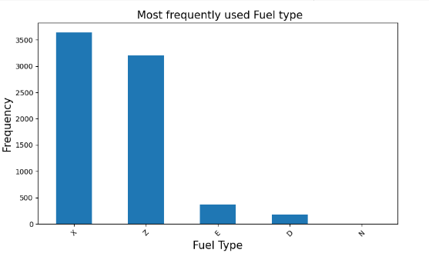
Frequency distribution of Transmission & Fuel type :-
Automatic with Select Shift cars are 2720 & Automatic cars are 1536
Most of the cars have AS transmission
4 different types of fuels used by cars have been identified and fuel X seems to be the most famous
.Majority of cars use fuel type X & Z

Slide 10
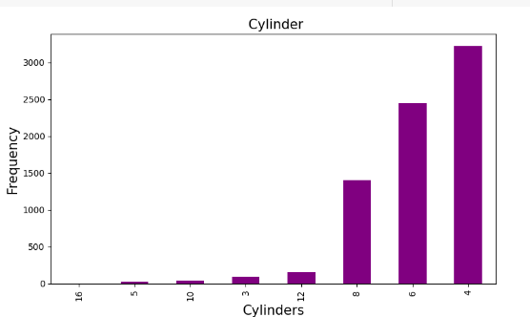
Frequency distribution of Cylinders
Most of cars have 4 Cylinders

Slide 11
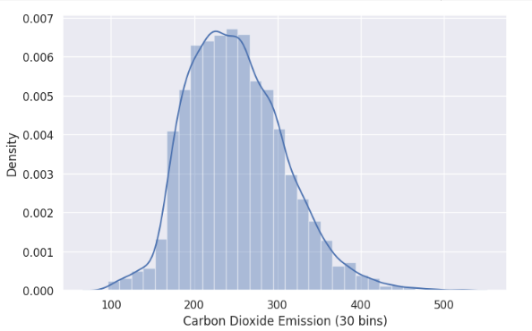
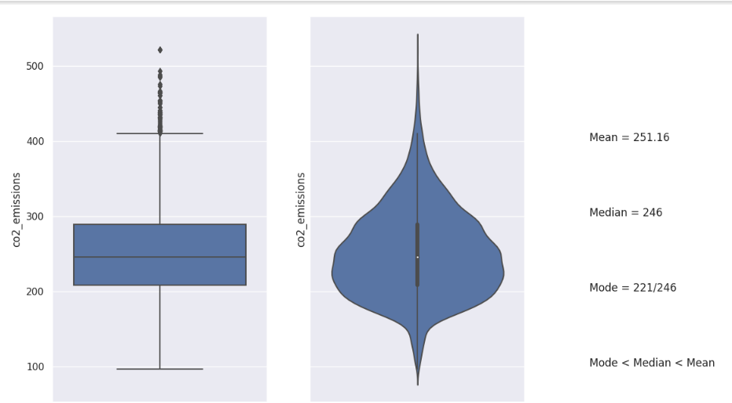
From Histogram ,we can see that Co2_Emissions is moderately positively skewed.
Analysis of target variable co2 emission :
All of the three statistics, the mean is the largest, while the mode is the smallest thus CO2_Emissions is positively skewed which implies that most of the CO2 Emissions are less than the average CO2 Emissions.

Slide 12
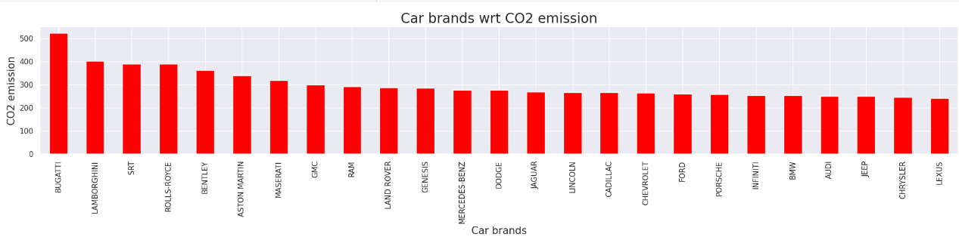
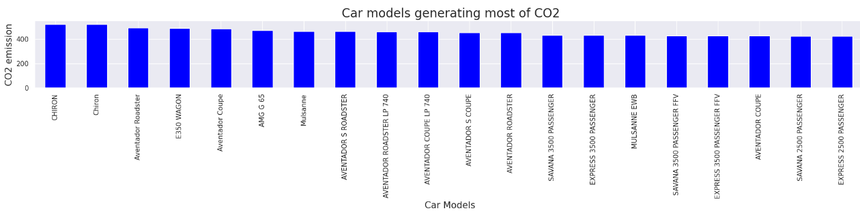
Features Distribution with respect to Co2 emission
CO2 Emissions v/s Make : While Ford cars are mainly found on the roads but its Bugatti that emit the most CO2 per car
CO2 Emissions v/s Model: Bugatti Chiron is amongst the most CO2 emitting car model

Slide 13
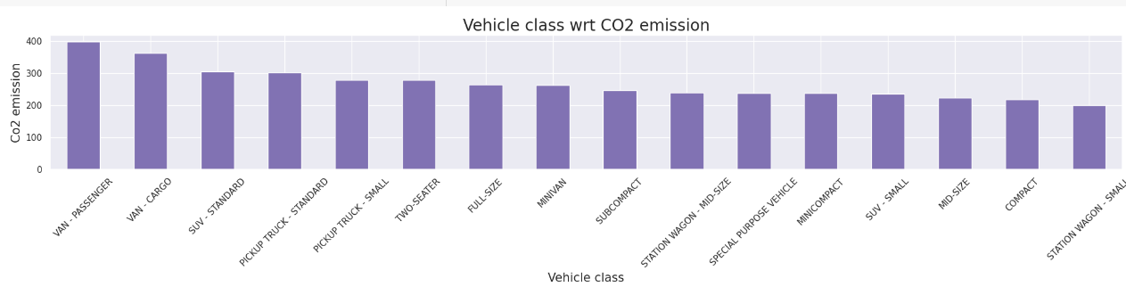
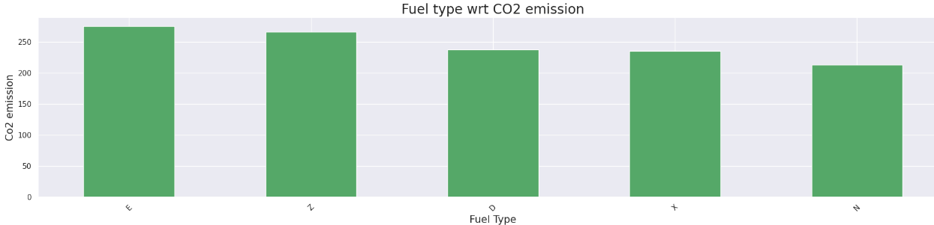
CO2 Emissions v/s Vehicle Class: Most of the heavy vehicles like Vans , SUV and Pick-up truck are amongst the top few emitters of CO2
CO2 Emissions v/s Fuel Type: Cars using Fuel Type E are emitting the most CO2

Slide 14
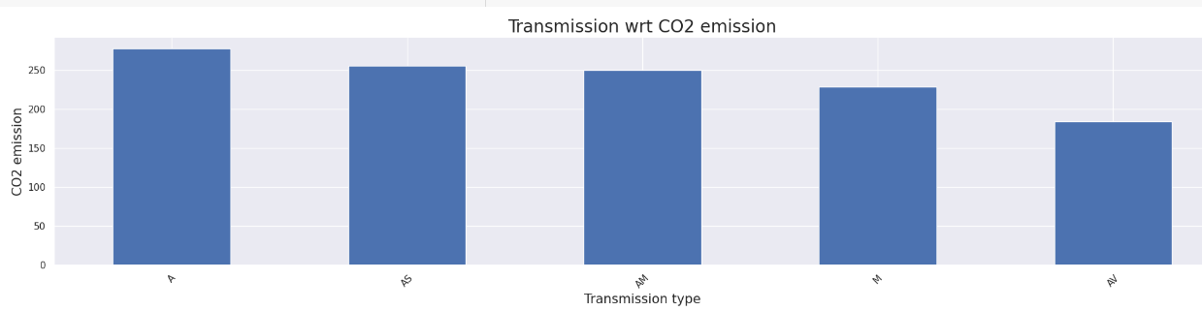
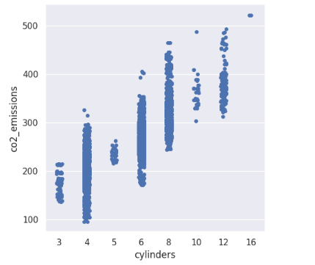
CO2 Emissions v/s Transmission: Most of the cars with automatic transmission emit CO2O2 Emissions v/s Fuel_Type: Cars using Fuel Type E are emitting the most CO2
From the scatter plot we can see that:
As the number of cylinders increase, the CO2 emissions increases. Cars with 8 and less than 8 cylinders prefer using Fuel Type X which result in less emissions of CO2. Fuel Type Z results in more CO2 emissions than the others

Slide 15
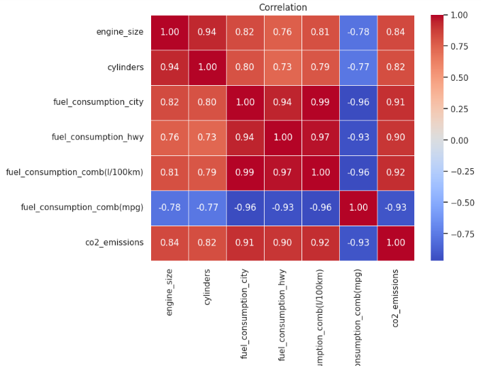
Fuel_Consumption_Comb1 has a high negative correlation(<-0.9) with CO2_Emissions, Fuel_Consumption_Comb and Fuel_Consumption_City CO2_Emissions has high positive correlation(>0.9) with Fuel_Consumption_Comb and Fuel_Consumption_City
Co relation matrix :

Slide 16

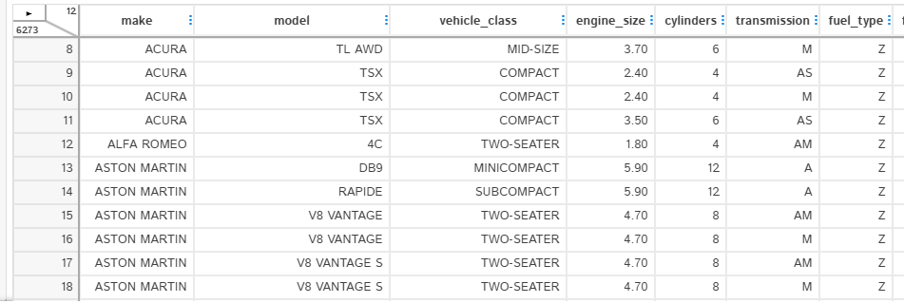
AUTOMATED EDA D-tale

Slide 17
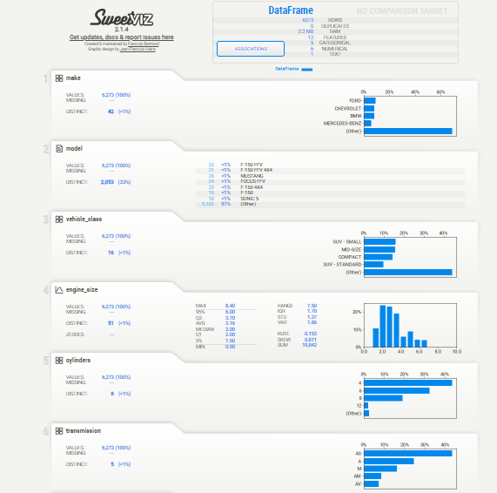
SWEETVIZ

Slide 18
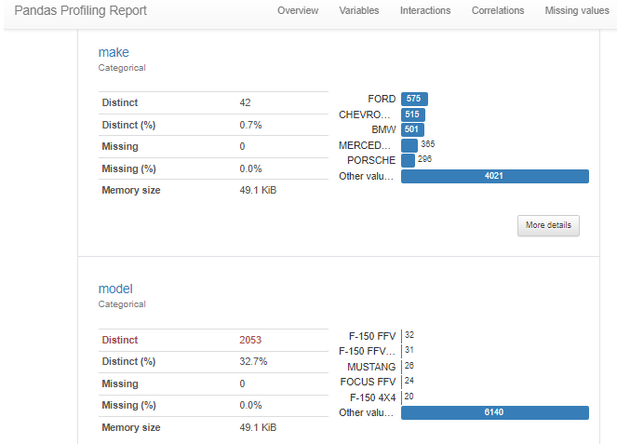
PANDAS PROFILING

Slide 19
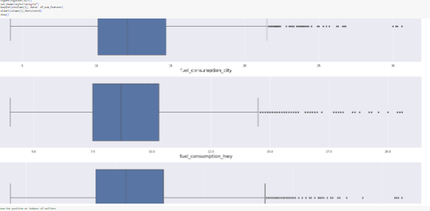
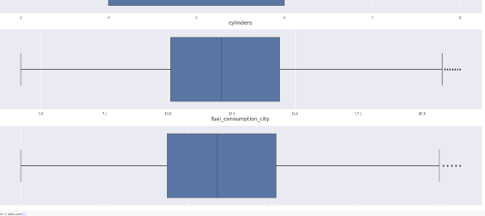
Outliers Detection & Imputation:
The dataset contains outliers so we used mean imputation to replace all outliers with mean values.

Slide 20
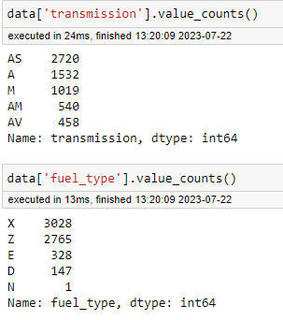
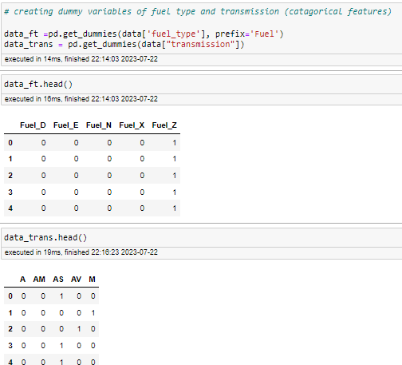
Converting categorical variables into numerical values :
Creating dummies for transmission and fuel type :

Slide 21
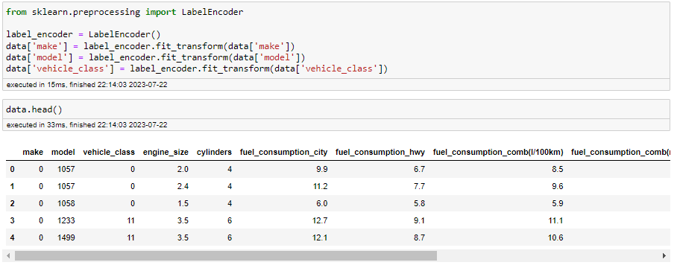
Label encoder :

Slide 22
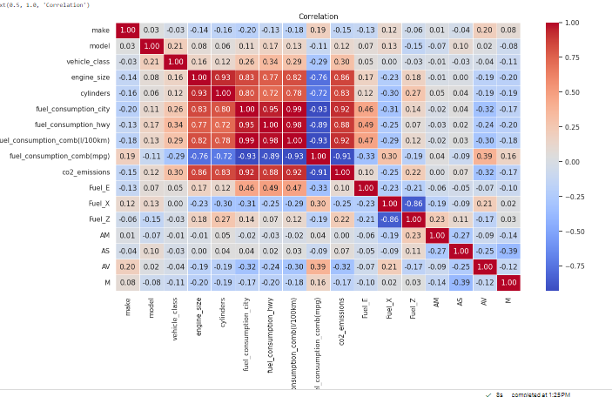
Correlation : Pearson's correlation matrix
This is correlation of all features of dataset after converting them in to dummy variables. Some independent variables showing strong correlation As it's above0.90.

Slide 23
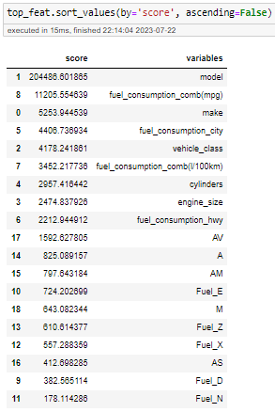
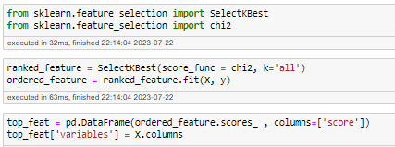
Features Selection For Model Building Using Chi Square Test :
By Using Chi square method we have taken top 15 features based on chi2 score which are useful for finding Co2 Emission. We removed features which have low scores.

Slide 24
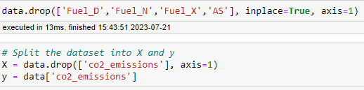

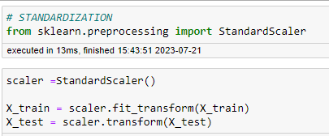
Dropping unnecessary features and splitting the data into training and testing data sets and doing standardization :

Slide 25

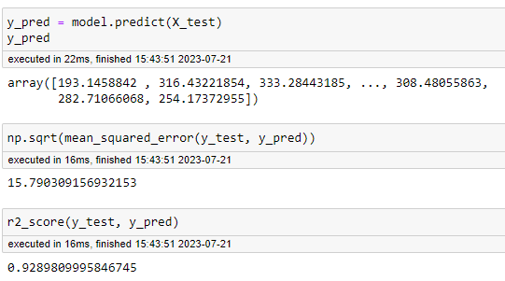
Model Building Linear Regression Model :

Slide 26
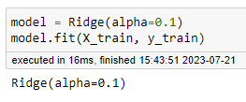
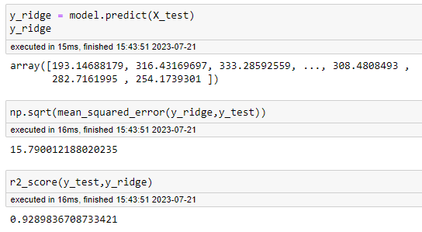
Ridge Regression Model:

Slide 27
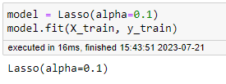
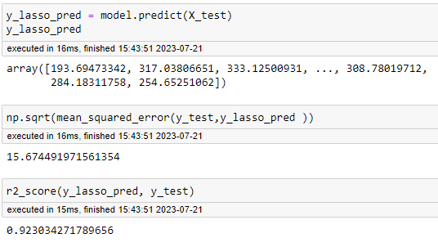
Lasso Regression Model :

Slide 28
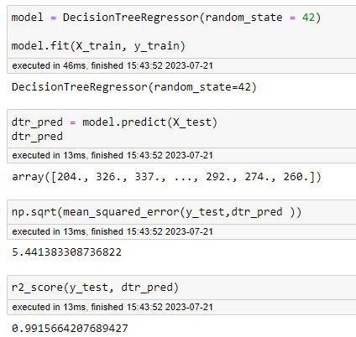
Decision Tree Model :

Slide 29
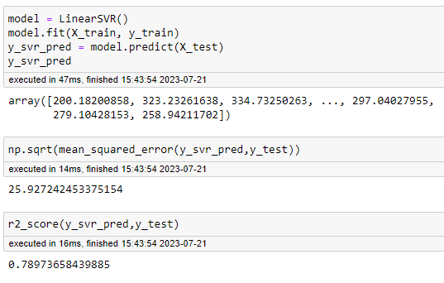
Support Vector Regressor Model :

Slide 30
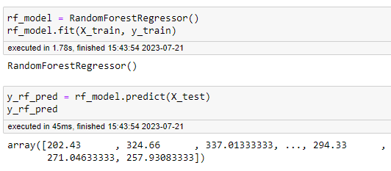
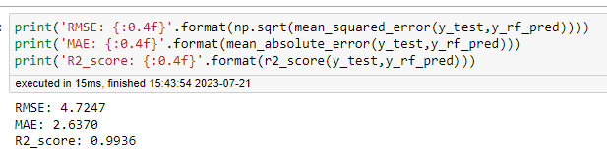
Random Forest Regressor Model :

Slide 31
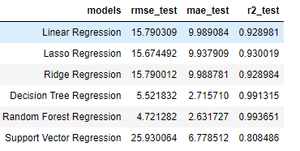
Random forest Regressor model has the lowest root mean square error, lowest mean absolute error and high accuracy so we will select this model for Model deployment.
All Models Performance Metrics Comparison :

Slide 32
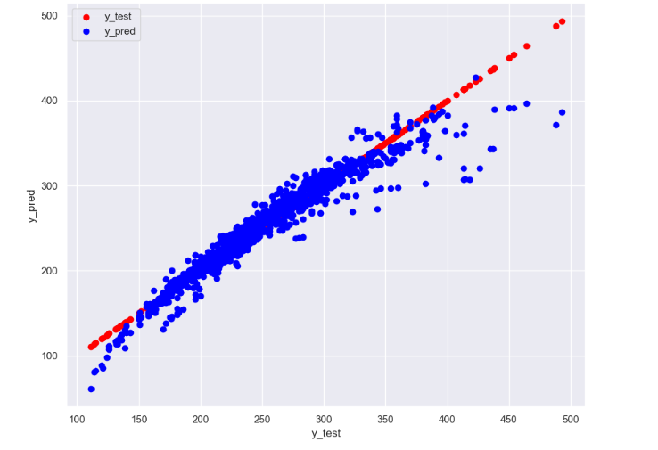
Scatter plot for Random Forest Regressor Model : y test vs ypred:

Slide 33
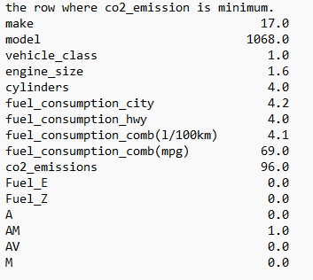
Model DEPLOYEMENT : we used streamlit for model deployment
Data where co2_emission is minimum we will check in model deployment

Slide 34
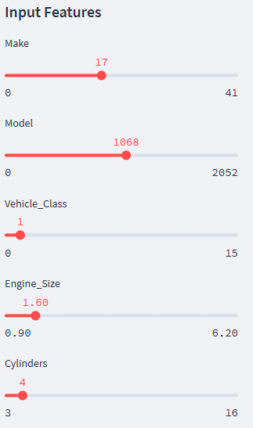
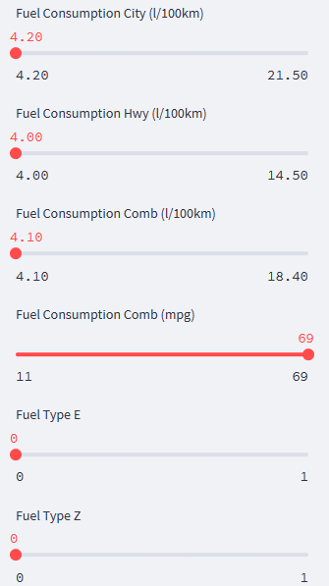
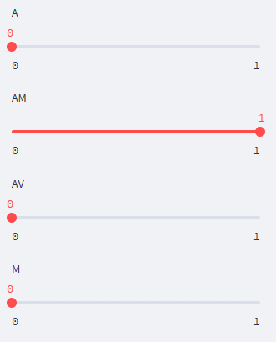

co2 emission prediction Input features:

Slide 35
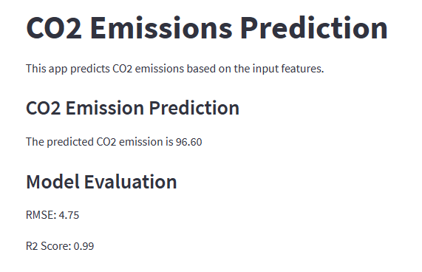
Co2 emission prediction value:

Slide 36
Challenges faced :
1. Data Quality : The accuracy of the model heavily relies on the quality of the data. Missing values, outliers, or inaccuracies in the data can lead to biased or incorrect predictions. When we where removing outliers we were facing problem which imputation method should is better to replace outliers we rectified the problem by analysing mean, median, mode of all features and use mean imputation where we replace all outliers in features with their respective mean value.
2. Feature Engineering : Selecting the right features that have a strong correlation with CO2 emissions is crucial. Identifying and engineering relevant features can be challenging and requires domain knowledge. The problem during feature selection was even after using different feature selection methods we were unable to select important features we rectified this problem by using chi2 test where we calculate chi square scores for all features and can remove the features with low chi square score value.
3. Scaling : Some features might have a significantly larger range than others. Scaling or normalizing the features is essential to ensure that the model is not dominated by certain variables. After converting all categorical features into numeric values now all the features in our data were numerical values when we checked model predictions were not at all good as the units of all features were different to rectify this we have done standardization and built the model and done predictions.

Slide 37
THANK YOU

